Slide 1


Slide 2

Problem-solving agents
Problem types
Problem formulation
Example problems
Basic search algorithms

Slide 3
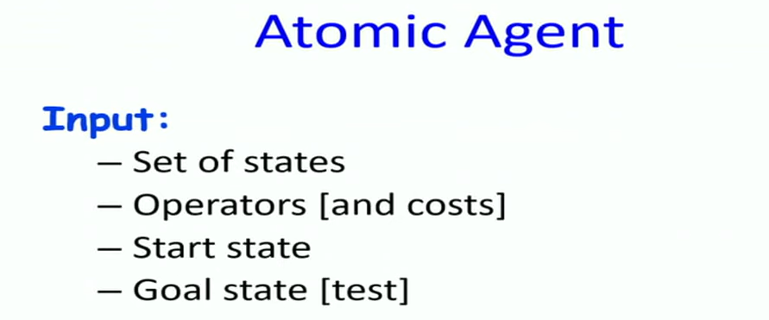
Problem-solving agents use atomic representations
For Shortest path problem representation is graph and every state is node, edges are operators, actions you can apply to move from one state to another state.
Chess playing, Robot Assembly are agent based complex problem.
Data structure is not enough to represent the NP hard problem
Notes:
Shortest path problem

Slide 4

Instead of defining different algorithms for different problems, a unified methodology can be used to solve a large class of problems.
Description of the problem is input and an automated problem solving methodology i.e. systematic searching approach for different problems to generate the output.
General representation of any problem using defined states.
State space representation for path finding problem: start state, goal state, map, locations etc.

Slide 5

State Space Search is used to model the problem.
In the state space graph, nodes represent the configuration and edges represent the possible moves from one configuration to another.
Any configuration can be modeled as a STATE.
The configuration must be a VALID CONFIGURATION.
STATE TRANSFORMATION RULES define the rules in moving from one state to another state thus producing the state space.
However, state spaces are very large, and sometimes even infinite.

Slide 6

Suppose an agent can execute several actions immediately in a given state
It doesn’t know the utility of these actions
Then, for each action, it can execute a sequence of actions until it reaches the goal
The immediate action which has the best sequence (according to the performance measure) is then the solution
Finding this sequence of actions is called search, and the agent which does this is called the problem-solver.
NB: Its possible that some sequence might fail, e.g., getting stuck in an infinite loop, or unable to find the goal at all.

Slide 7

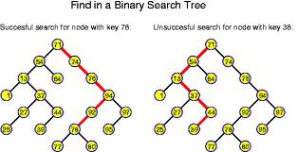
You can begin to visualize the concept of a graph
Searching along different paths of the graph until you reach the solution
The nodes are the states
The whole graph can be the state space
The links are equivalent to the actions……

Slide 8

Static: The configuration of the graph (the city map) is unlikely to change during search
Observable: The agent knows the state (node) completely, e.g., which city I am in currently
Discrete: Discrete number of cities and routes between them
Deterministic: Transiting from one city (node) on one route, can lead to only one possible city
Single-Agent: We assume only one agent searches at one time, but multiple agents can also be used.

Slide 9

A problem is defined by five items:
  An Initial state
  Possible actions available, ACTIONS(s) returns the set of actions that can be executed in s.
  A successor function S(x) = the set of all possible {Action–State} pairs from some state
  Goal test, can be
    explicit, e.g., x = Bucharest
    implicit, e.g., Checkmate(x)
  Path cost (additive)
    e.g., sum of distances, number of actions executed, etc.
    c(x,a,y) is the step cost, assumed to be ≥ 0
A solution is a sequence of actions leading from the initial state to a goal state.

Slide 10

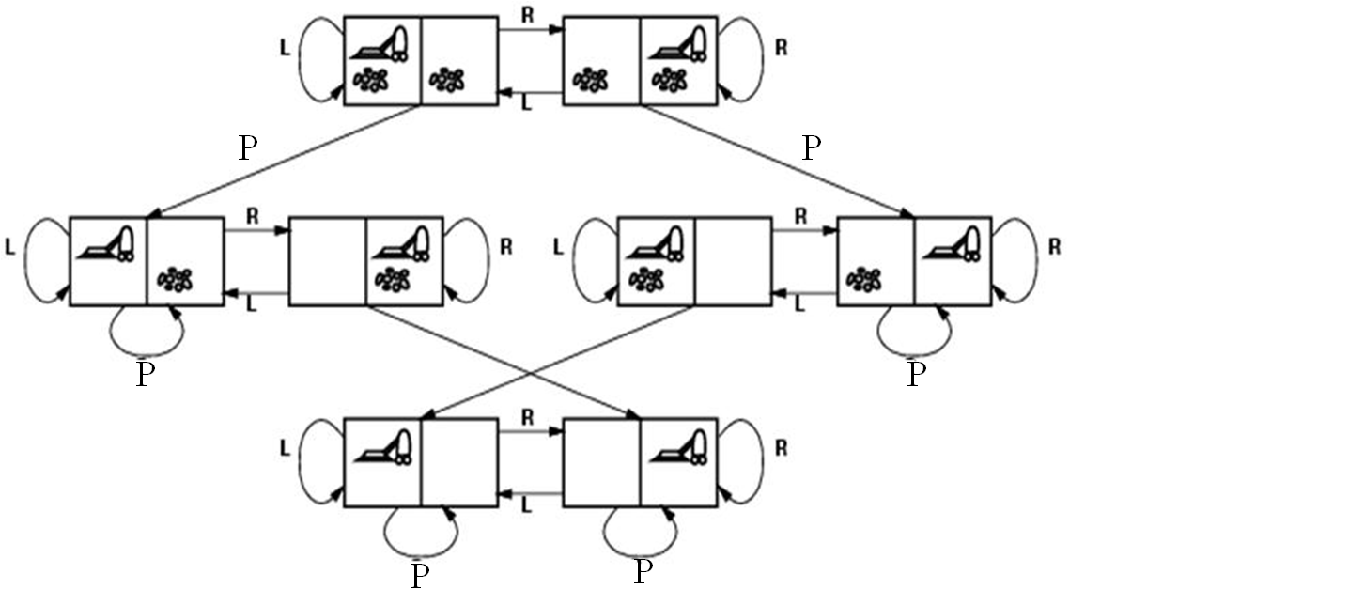
States? Actions?
Goal test? Path cost?

Slide 11

States? dirt and robot location
Actions? Left, Right, Pick
Goal test? no dirt at all locations
Path cost? 1 per action

Slide 12


States?
Actions?
Goal test?
Path cost?
The 8-puzzle, consists of a 3×3 board with eight numbered tiles and a blank space.
A tile adjacent to the blank space can slide into the space.
The object is to reach a specified goal state.

Slide 13

States? locations of tiles
Actions? move blank left, right, up, down
Goal test? = goal state (given)
Path cost? 1 per move
The 8-puzzle belongs to the family SLIDING-BLOCK of sliding-block puzzles, which are often used as PUZZLES test problems for new search algorithms in AI.
This family is known to be NP-complete,
The 8-puzzle has 9!/2=181, 440 reachable states 15-puzzle (on a 4×4 board) has around 1.3 trillion states
Random instances can be solved optimally in a few milliseconds by the best search algorithms.
The 24-puzzle (on a 5 × 5 board) has around 1025 states, and random instances take several hours to solve optimally.

Slide 14
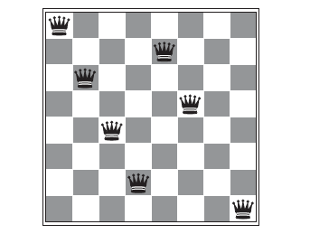
The goal of the 8-queens problem is to place eight queens on a chessboard such that no queen attacks any other. (A queen attacks any piece in the same row, column or diagonal.)
States: Any arrangement of 0 to 8 queens on the board is a state.
• Initial state: No queens on the board.
• Actions: Add a queen to any empty square.
• Transition model: Returns the board with a queen added to the specified square.
• Goal test: 8 queens are on the board, none attacked.
In this formulation, we have 64 ・ 63 ・ ・ ・ 57 ≈ 1.8×10¹⁴ possible sequences to investigate

Slide 15


States?: real-valued coordinates of robot joint angles, parts of the object to be assembled, current assembly
Actions?: continuous motions of robot joints
Goal test?: complete assembly
Path cost?: time to execute

Slide 16


Basic idea:
  Offline (not dynamic), simulated exploration of state space by generating successors of already-explored states (a.k.a. expanding the states)
  The expansion strategy defines the different search algorithms.

Slide 17



Slide 18


Slide 19


Slide 20

Fringe: The collection of nodes that have been generated but not yet expanded
Each element of the fringe is a leaf node, with (currently) no successors in the tree
The search strategy defines which element to choose from the fringe
fringe
fringe

Slide 21


A state is a representation of a physical configuration
A node is a data structure constituting part of a search tree includes state, parent node, action, path cost g(x), depth
The Expand function creates new nodes, filling in the various fields and using the SuccessorFn of the problem to create the corresponding states.

Slide 22

A search strategy is defined by picking the order of node expansion
Strategies are evaluated along the following dimensions:
  Completeness: Does it always find a solution if one exists?
  Time complexity: Number of nodes generated
  Space complexity: Maximum number of nodes in memory
  Optimality: Does it always find a least-cost solution?
Time and space complexity are measured in terms of
  b: maximum no. of successors of any node
  d: depth of the shallowest goal node
  m: maximum length of any path in the state space.

Slide 23
Types of search algorithms
Based on the search problems we can classify the search algorithms into uninformed (Blind search) search and informed search (Heuristic search) algorithms.
Uninformed/Blind Search:
The uninformed search does not contain any domain knowledge such as closeness, the location of the goal.
It operates in a brute-force way as it only includes information about how to traverse the tree and how to identify leaf and goal nodes.
Breadth-first search
Uniform cost search
Depth-first search
Iterative deepening depth-first search
Bidirectional Search

Slide 24
Informed Search
Informed search algorithms use domain knowledge.
In an informed search, problem information is available which can guide the search.
Informed search strategies can find a solution more efficiently than an uninformed search strategy.
Informed search is also called a Heuristic search.
A heuristic is a way which might not always be guaranteed for best solutions but guaranteed to find a good solution in reasonable time.
An example of informed search algorithms is a traveling salesman problem.
Greedy Search
A* Search

